Slide 1

Online Simulator
By Catey Meador

Slide 2

Overview
Originally a card game
Meme prompt cards
Text response cards
Goal: create an online sim

Slide 3
Specifications/Functional Requirements
Necessary
Users should be able to:
Create a game
Join a game using a code
Select a response card
Eventually be able to view each players response in the round
Select their favorite pairing (as judge or voter)
The system should:
Assign a code to a new game when it is created
Deal each player a hand of response cards
Deal a prompt card
Add players to their game corresponding to the code they enter
End the game when the win condition is met
Administrator should be able to:
Add pre-set decks of response cards
Add pre-set decks of prompt cards
Potential
Users should be able to:
Create an account
Choose how many points the winner must get before the game ends
Choose between a rotating judge or group vote
Add their own photos as prompt cards
Add their own text as prompt cards
Add their own captions as response cards
Add their own photos as response cards
Make a drawing as a prompt card
Make a drawing as a response card
Have an option of 9 different game modes (different combinations of text, photo, and drawing prompt and responses; such as text-text, text-photo, photo-drawing, etc.)
Save created cards to their account for re-use
Choose for a prompt card redraw (as judge or by vote)

Slide 4
Non-functional Requirements
Mobile friendly or mobile app
There should be separate log-ins for admin and regular user
Access permissions will only be changed by the administrator
Log-in passwords will be 8-15 characters with at least one uppercase, one lowercase, and one number or special character
Passwords will be encrypted
All text will be in English
System will be operational 24 hours a day
System will be accessible worldwide
Should be accessible to anyone with web browser capabilities
Should be usable on any web browser
Response times should be reasonable

Slide 5
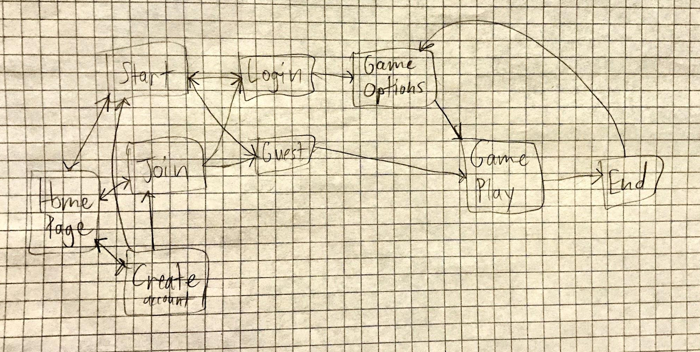
Page Diagram

Slide 6
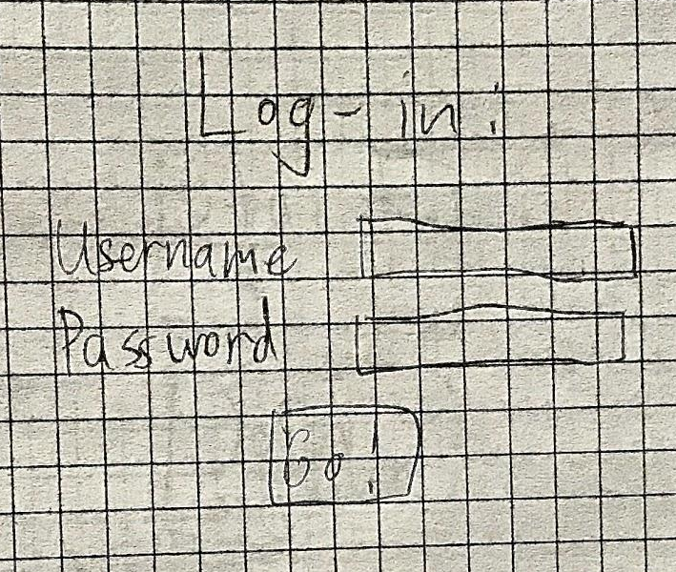
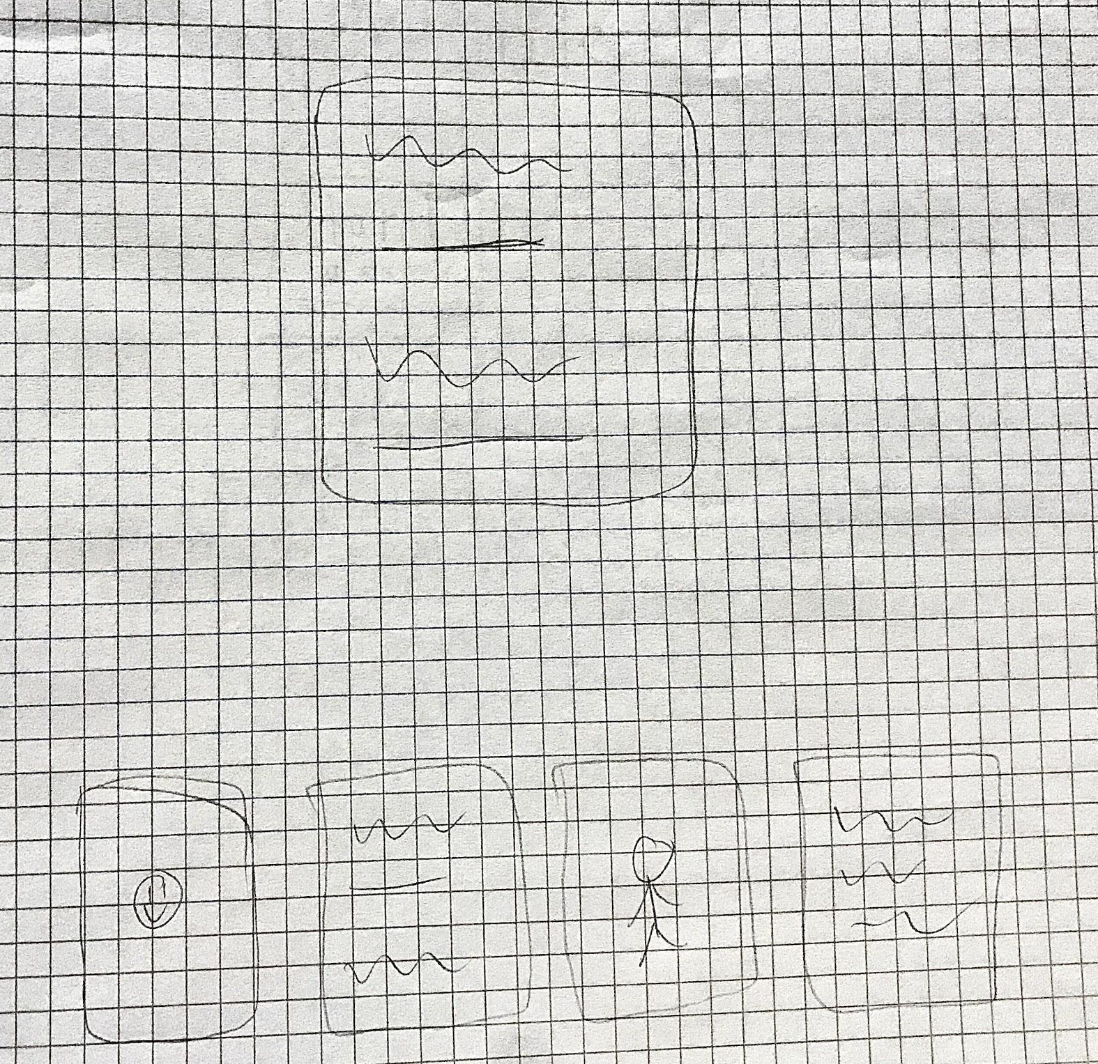
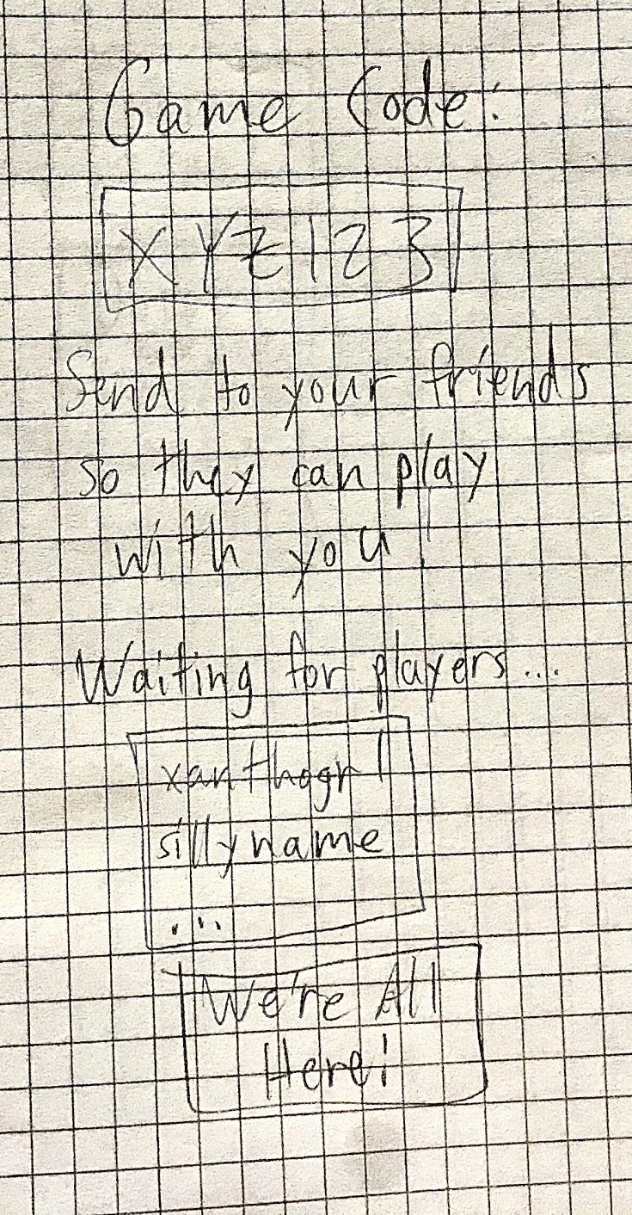
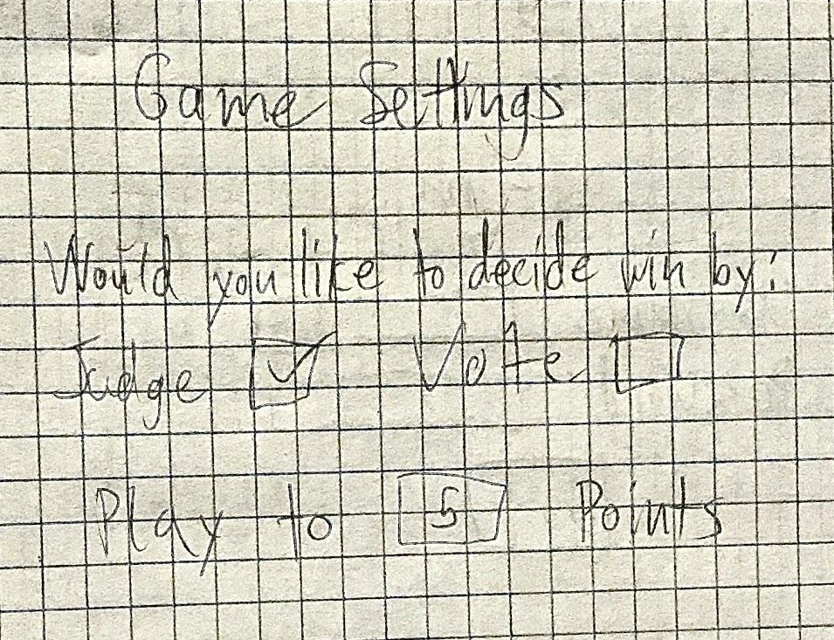
Page Examples

Slide 7
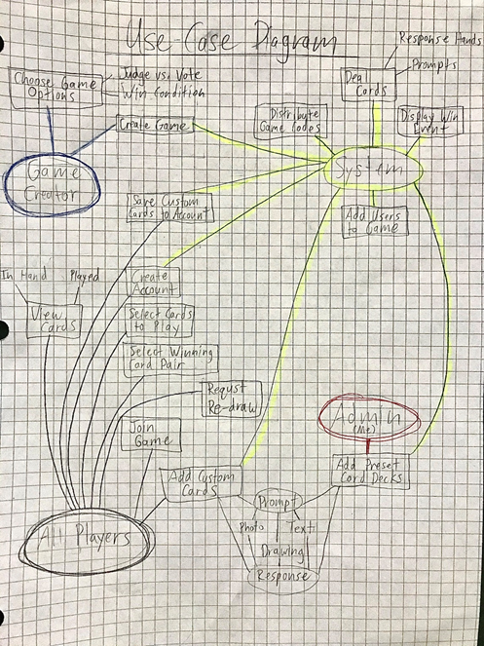

Slide 8
